Slide 1


Bapuji Educational Association®
Bapuji Institute of Engineering and Technology
Davangere-577 004
Department of Electronics & Communication Engineering
2023-24
SMART GLASSES FOR THE BLIND
Project Associates,
NANDEESH G U. 4BD21EC053
NAVEEN R D. 4BD21EC055
NIKHIL K H. 4BD21EC057
NIKITHA S G. 4BD21EC059
Dr. G S SUNITHA
M.Tech. (DEAC), Ph.D., MISTE, FIETE, FI E
PROGRAM COORDINATOR
Dr.NIRMALA S O
PROJECT GUIDE

Slide 2
BAPUJI INSTITUTE OF ENGINEERING AND TECHNOLOGY, DAVANGERE-577004
Vision
To be a centre of excellence recognized nationally and internationally, in distinctive areas of engineering education and research, based on a culture of innovation and invention.
Mission
BIET contributes to the growth and development of its students by imparting a broad based engineering education and empowering them to be successful in their chosen field by inculcating in them positive approach, leadership qualities and ethical values.

Slide 3
Department of Electronics and Communication Engineering
Vision
To be in the forefront in providing quality technical education and research in Electronics & Communication Engineering to produce skilled professionals to cater to the challenges of the society.
Mission
To facilitate the students with profound technical knowledge through effective teaching learning process for a successful career.
To impart quality education to strengthen students to meet the industry standards and face confidently the challenges in the programme.
To develop the essence of innovation and research among students and faculty by providing infrastructure and a conducive environment.
To inculcate the student community with ethical values, communication skills, leadership qualities, entrepreneurial skills and lifelong learning to meet the societal needs.

Slide 4
Course Learning Objectives(21ECMP67)
This course will enable us to:
1) Understand and analyze an engineering problem.
2) Acquire technical knowledge and collect the information.
3) Enhance communication, technical presentation and report preparation skills.
4) Provide an opportunity to exercise the creative and innovative ideas in group.

Slide 5
Table of Contents
1. Abstract
2. Introduction
3. Problem Statement
4. Objectives
5. Literature Review
6. Methodology
7. Working
8. Result and Discussions
9. Advantages
10. Applications
11. Limitations
12. Conclusion
Reference

Slide 6
Abstract
Smart glasses includes a pair of glasses, an obstacle detection module fitted in it in the center.These Ultrasonic Smart Glasses for Blind people is a portable device, easy to use, light weight, user friendly and cheap in price. These glasses could easily guide the blind people and help them avoid obstacles.

Slide 7
Introduction
Blindness is a highly widespread impairment among people all over the world. Worldwide, 285 million people are visually impaired, 39 million are blind, and 246 have low vision, according to the World Health Organization (WHO). Around 90% of people who are blind or visually impaired reside in developing nations. There was a solution for the blind people to walk safely by detecting obstacle and generating corresponding alert signal according to the distance of the obstacle. This smart glasses can help blind people navigate safely by alerting them about obstacles in their way. Using basic electronic parts like sensors and timers, we’ve made glasses that can detect obstacles and warn the wearer with a sound.

Slide 8
PROBLEM IDENTIFICATION
One of the most misunderstood disabilities is blindness. The general populace has preconceptions about the blind that they feel are accurate.
Some people feel that the blind can't work or live a regular life on their own. There is some truth in the public's perception, as the blind do experience difficulties.
Some of these challenges include being unable to move, requiring assistance from others, and so on. It can be difficult to perceive an obstacle or detect it in time.

Slide 9
OBJECTIVES
The ultrasonic smart glasses is an innovative glasses designed for visually disabled people for improved navigation.
Deliver Real-Time Feedback is to Ensure the glasses can quickly process and relay information about obstacles and surroundings without causing delays or confusion.
It is Cost efficiency, Light weight, Portable & easy to use.

Slide 10
Literature Review
PREVIOUS WORK:
System For Blind People (International Journal of Open Information Technologies ISSN: 2307-8162 vol. 7, no.5, 2019.
It provided GPS-based real-time help and was incredibly comfortable, simple to use, and effortless to navigate. Smart sticks powered by Raspberry Pi can detect objects and alert the blind via buzzer sound.A thorough analysis of the suggested system will aid in choosing a novel approach to the current system.
2. S.Chew , “Electronic Path Guidance for Visually Impaired People”, The International Journal Of Engineering
And Science (IJES), Vol.2, No.4, pp.9-12, April 2012
Blind spot, a smart white cane that integrates GPS technology, social networking, and ultrasonic sensors to aid those with visual impairments in navigating public settings, was proposed. By employing ultrasonic sensors, the GPS locates the barrier and warns the blind to avoid running into it. However, since ultrasonic measures the distance of the obstruction, GPS did not demonstrate its effectiveness in tracing its location. .

Slide 11
Rohit agarwal (2020) “low cost ultrasonic smart glasses for blind”
Suggested a mechanism to aid users who are blind in their navigation. The suggested architecture and design will make it possible for blind individuals to walk around freely and independently. In this article, we examined the current electronic assistive devices for the blind. In comparison to existing systems, the one that was offered was more beneficial and effective. In terms of localisation, it will be able to accurately pinpoint the blind person's location with the aid of the GPS in the event that s/he gets lost or encounters any hazard.
GAP ANALYSIS:
Describes the obstacles detection module, which is mounted on sunglasses and equipped with an ultrasonic sensor, a processing unit, and a buzzer that detects impediments and emits a buzzing sound to assist the blind.

Slide 12
Description
A smart ultrasonic glasses for blind people comprises of a pair of wearable glasses, ultrasonic sensors for detection of obstacles in the way of blind man, a buzzer to give the sound as per the direction of the obstacle from the man, a central processing unit comprising of 555 Timer which takes the information from the sensor about the obstacle distance and sends the output through the buzzer, power supply is given to the central unit which distributes the power to different components. The sensor is mounted in between of the top bar and bridge present in optical glasses. All the components are connected to the central unit using single strand copper wires.

Slide 13
Hardware Requirements for Smart Glasses
555 Timer IC
Ultrasonic sensor
10k ohm preset potentiometer
10 microfarad capacitor
Goggles or glasses
1k ohm resistor
Buzzer
TP4056 Charging Module
3.7v battery

Slide 14
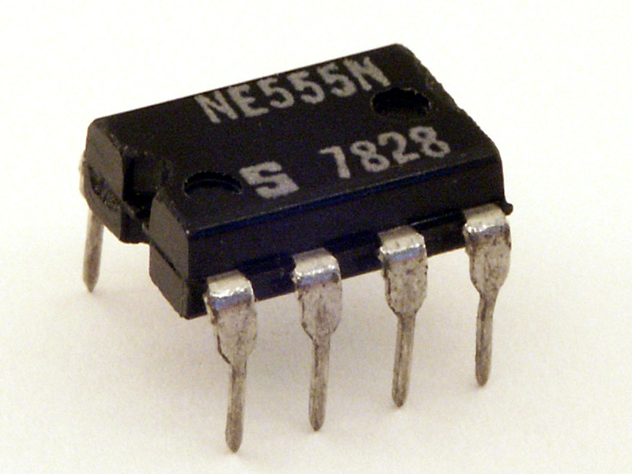
1 . 555 Timer IC: The 555 timer IC is an integrated circuit used in a variety of timer, delay, pulse generation, and oscillator applications. It is one of the most popular timing ICs due to its flexibility and price. Derivatives provide two or four timing circuits in one package.
In this smart glasses project, the 555 Timer IC creates timing generating (PWM) or pulse-width modulation signals for the buzzer.

Slide 15
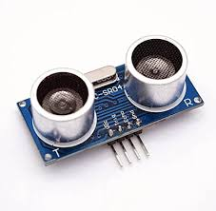
2. Ultrasonic sensor: Ultrasonic sensors can measure distance and detect the presence of an object without making physical contact. They do so by producing and monitoring an ultrasonic echo. Ultrasonic sensors use sound waves above the 20 kHz range to detect objects.
The ultrasonic sensor is the primary input device, providing information about obstacle in the wearer’s path.

Slide 16
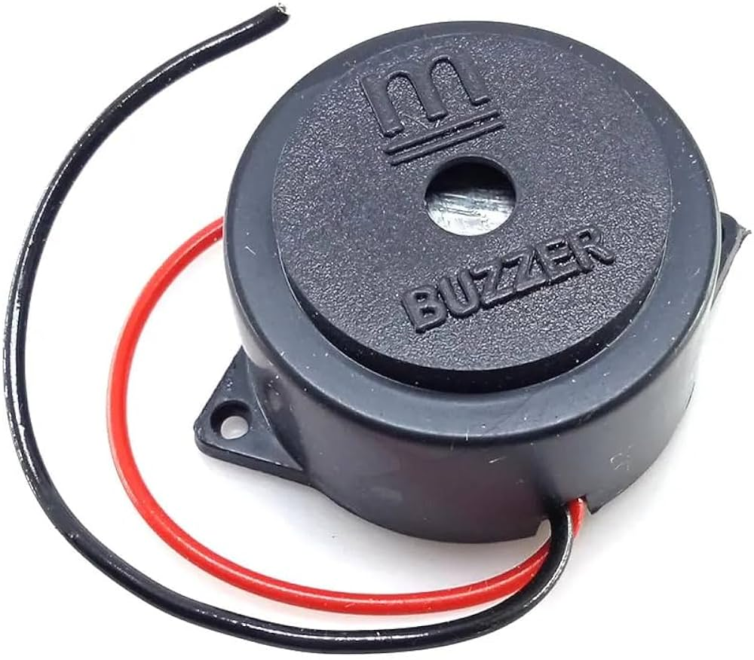
3.Buzzer:Buzzer meaning electronic component that generates sound through the transmission of electrical signals. Its primary function is to provide an audible alert or notification and typically operates within a voltage range of 5V to 12V.
The buzzer is used to provide auditory feedback to the wearer about the presence of obstacles

Slide 17
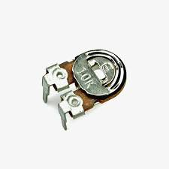
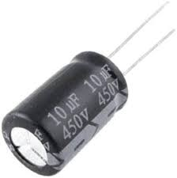
4. 10k ohm preset potentiometer: The potentiometer (variable resistor) allows you to adjust resistance manually. In our project, it is used for sensitivity adjustment of the ultrasonic sensor.
5 . 10 microfarad capacitor: The capacitor filters or smoothes out electrical signals. For example, it helps to stabilize voltage levels and reduce noise in the power supply.

Slide 18
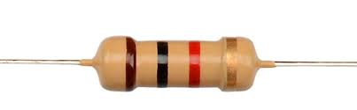
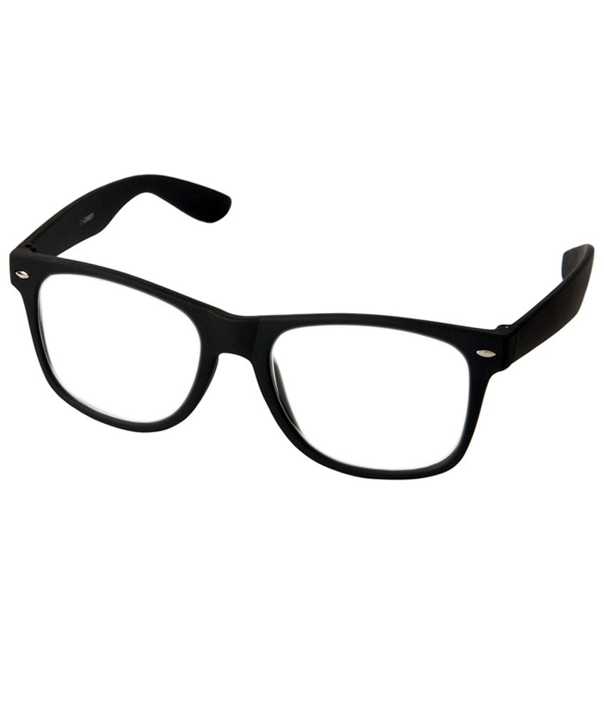
6 . 1k ohm resistor: The 1k ohm resistor is used in various parts of the circuit to control current flow and limit voltage levels for signal conditioning.
7.Goggles or glasses: These are the mounts for the electronic components. The glasses provide the wearable option

Slide 19
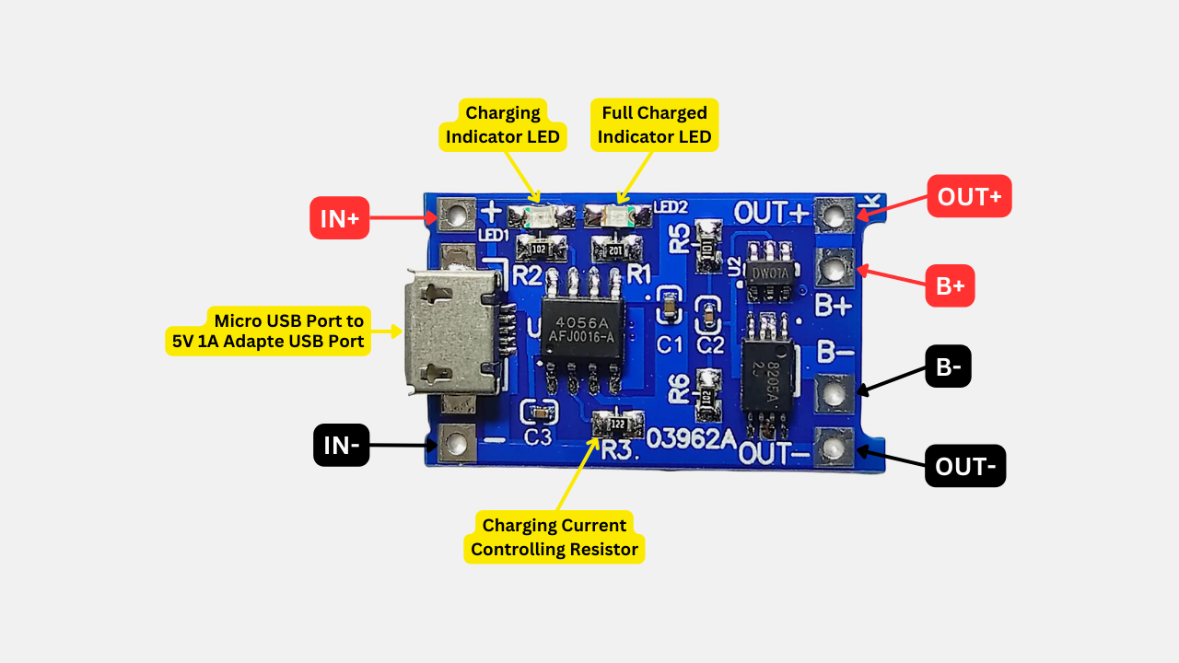
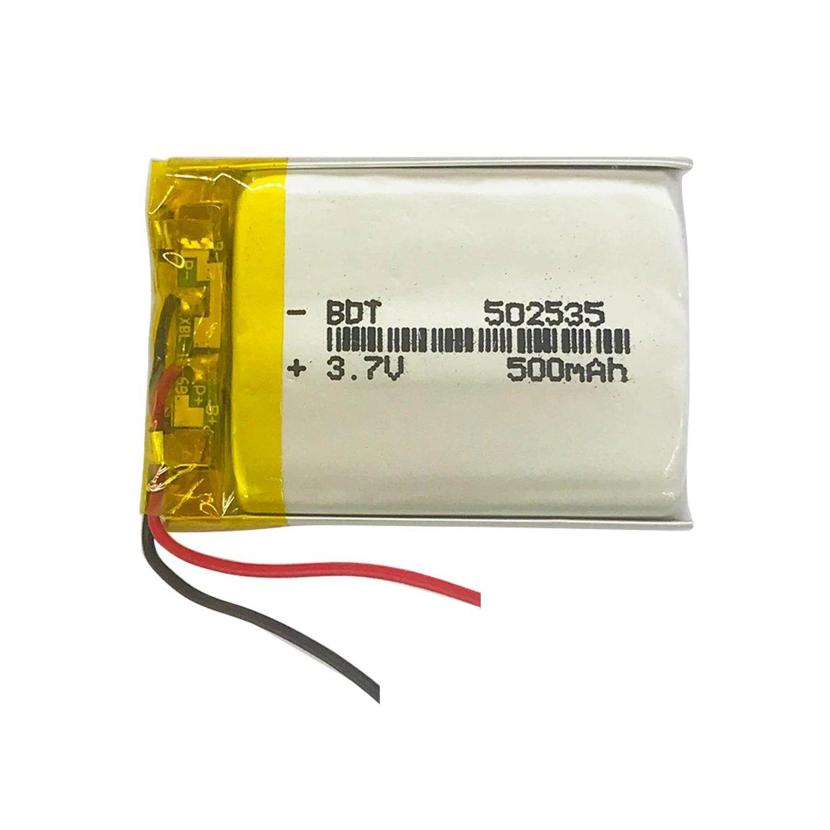
8. TP4056
This module can charge and discharge Lithium batteries safely
Suitable for 3.7V batteries
Charging current 1A
Input Voltage: 4.5V to 5.5V
Full charge voltage 4.2V
Protects battery from over charging and over discharging
9 . 3.7v Battery: The battery is the power source for your smart glasses. It provides the necessary power to operate all the components

Slide 20
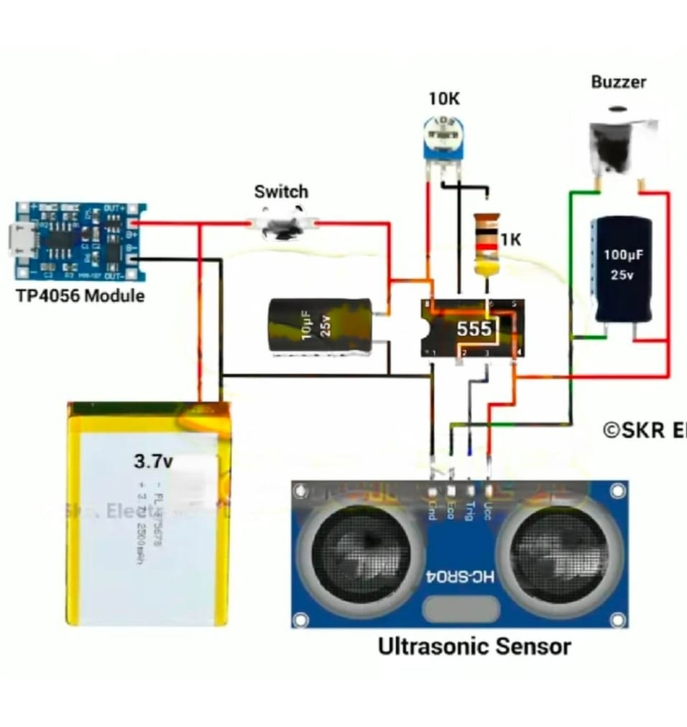
SCHEMATIC DIAGRAM

Slide 21
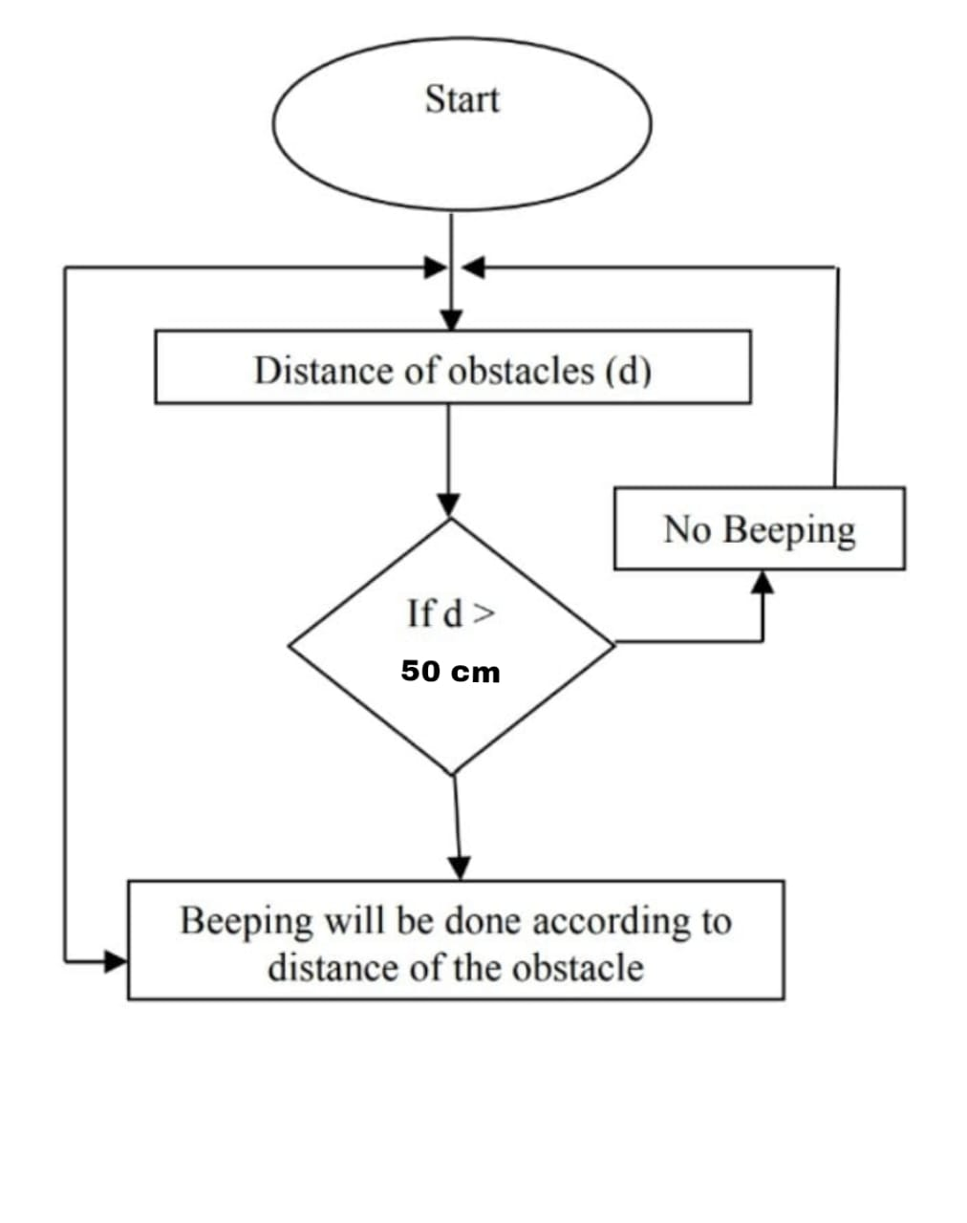
Flow Chart:

Slide 22
Working:
When the switch is turned on, the 555 IC starts generating a triggering signal.The triggering signal triggers the ultrasonic sensor and emits a high frequency ultrasonic wave.
When any object comes in front of the ultrasonic sensor, the ultrasonic wave from the sensor will reflect on the object and return to the receiver.
The sensor calculates the distance to the obstacle based on the time taken for the ultrasonic waves to return to the receiver.
If an obstacle is detected within a predefined range, the echo pin of the ultrasonic sensor sends a signal to the buzzer.
Then the buzzer starts buzzing sound to alert the blind person about the obstacle.Overall, this projects or circuit helps the blind individuals navigate their surroundings safely by alerting them to obstacles in their path.

Slide 23
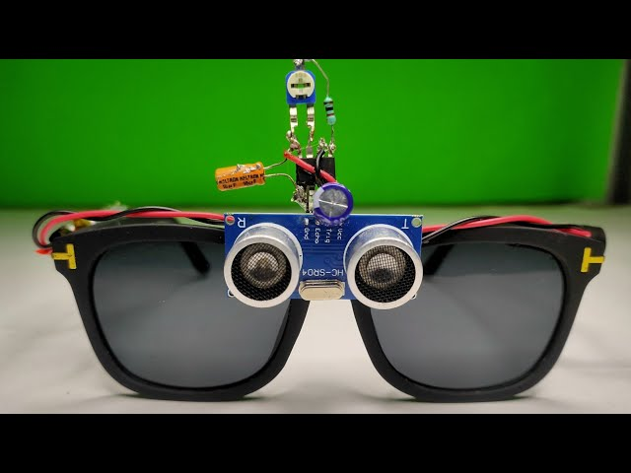
RESULTS AND DISCUSSION :
The system is created and designed for visually impaired people. This device helps the visually impaired people to handle several states and responds to the user in every environment. All the conditions can be easily met by the blind individual using ultrasonic sensor. This device will help the visually impaired people to know about the obstacles in forward direction.

Slide 24
ADVANTAGES:
Guides blind people.
Efficient low cost design.
Low power consumption.
Simple to use.
APPLICATIONS :
It works as a navigation device for blind people.
This system can be used to navigate by everyone not only visually impaired under certain circumstances , like foggy mornings with low visibility. Some winter mornings are foggy , where the visibility is very low , then this system can be used.
Help blind people to easily walk to destination.
Help blind people for obstacle detection.

Slide 25
LIMITATIONS:
Battery Life: Without efficient power management strategies, smart glasses might have shorter battery life, limiting their usability.
Sensor Range and Accuracy: Many smart glasses use cameras or ultrasonic sensors for obstacle detection, but these sensors may have limited range or accuracy, making it challenging to detect obstacles that are very close or very far away.

Slide 26
CONCLUSION :
In conclusion, smart glasses represent a transformative innovation in enhancing the daily lives of blind individuals by providing them with unprecedented capabilities and accessibility. These devices leverage advanced technologies such as artificial intelligence, augmented reality, and sensor integration to offer features like real-time object recognition, navigation assistance, and environmental feedback.

Slide 27
REFERENCES:
Dr. Sankit Kassa, Manisha Inchanalkar, Amisha Kamble, Mayuri Inchanalkar Department of Electronics Engineering, SNDT University
Professor, Department Of Computer Engineering, Smt. Kashibai Navale College Of Engineering, Pune, Maharashtra, India. DOI :
https://www.doi.org/10.56726/IRJMETS35135’
https://youtu.be/AIcSqeTR3cY?si=-mGpzT3w6ywxZDu8

Slide 28
COURSE OUTCOMES:
On completion of this course, students are able to
1) Solve the identified problems.
2) Analyze the available resources and their utilization
3) Present the work carried out and prepare the report
4) Work in a team to find the solutions for societal and technical problems.

Slide 29

THANK YOU

